Slide 1

INSTITUTE : UIE
DEPARTMENT : CSE
Bachelor of Engineering (Computer Science & Engineering)
PROJECT BASED LEARNING IN JAVA
(20CST-319/20ITT-319)
TOPIC OF PRESENTATION:
Multithreading in Java. Thread Priority, Thread LifeCycle.
DISCOVER . LEARN . EMPOWER

Slide 2

Lecture Objectives
In this lecture, we will discuss:
Multithreading in Java. Thread Priority, Thread LifeCycle.

Slide 3
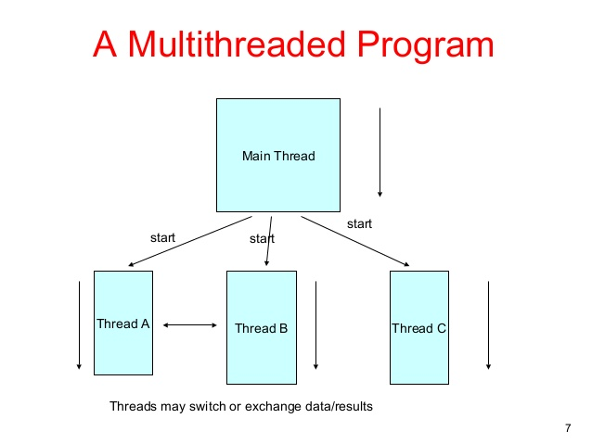
Multithreading
Multithreading is a Java feature that allows concurrent execution of two or more parts of a program for maximum utilization of CPU.
Each part of such program is called a thread. So, threads are light-weight processes within a process.

Slide 4
Use of Multithreading
• A multithreaded application performs two or more activities concurrently
• It is accomplished by having each activity performed by a separate thread
• Threads are the lightest tasks within a program, and they share memory space and resources with each other

Slide 5
QUIZ:
Choose Correct option which defines the multithreaded programming
1.It is a process in which a single process can access information from many sources
2.It is a process in which many different process are able to access same information
3.It is a process in which two different processes run simultaneously
4.It is a process in which two or more parts of same process run simultaneously

Slide 6
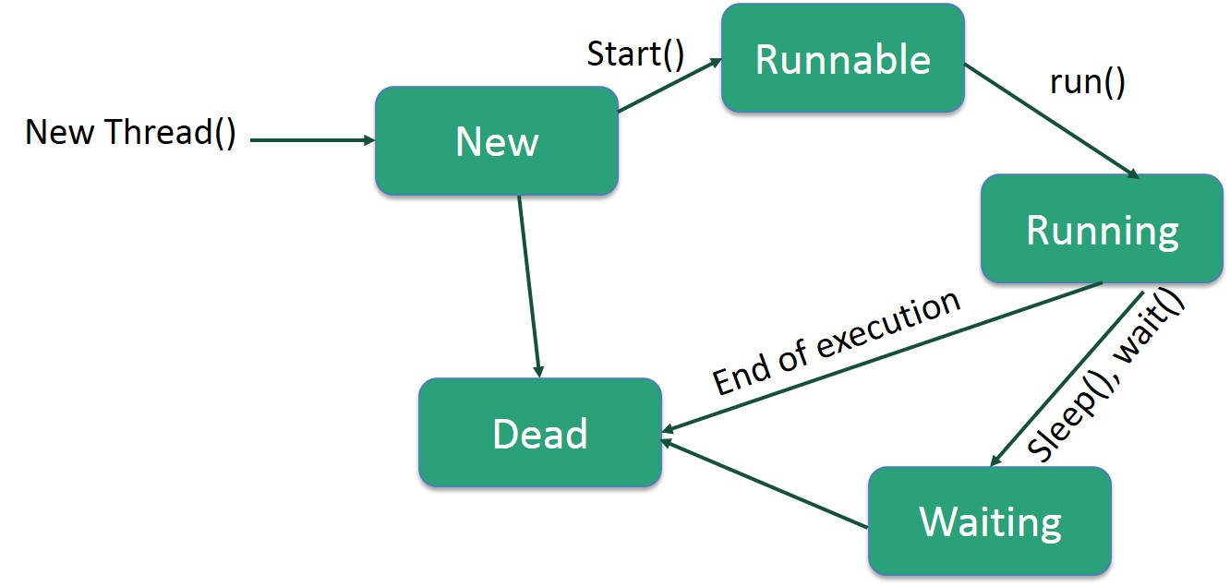
Life Cycle of a Thread
A thread goes through various stages in its life cycle. For example, a thread is born, started, runs, and then dies. The following diagram shows the complete life cycle of a thread.

Slide 7
Following are the stages of the life cycle −
New − A new thread begins its life cycle in the new state. It remains in this state until the program starts the thread. It is also referred to as a born thread.
Runnable − After a newly born thread is started, the thread becomes runnable. A thread in this state is considered to be executing its task.
Waiting − Sometimes, a thread transitions to the waiting state while the thread waits for another thread to perform a task. A thread transitions back to the runnable state only when another thread signals the waiting thread to continue executing.
Timed Waiting − A runnable thread can enter the timed waiting state for a specified interval of time. A thread in this state transitions back to the runnable state when that time interval expires or when the event it is waiting for occurs.
Terminated (Dead) − A runnable thread enters the terminated state when it completes its task or otherwise terminates.

Slide 8
Advantages of a Multithreaded Application
Improved performance and concurrency
Simplified coding of remote procedure calls and conversations
Simultaneous access to multiple applications
Reduced number of required servers

Slide 9
Disadvantages of a Multithreaded Application
Multithreaded applications present the following disadvantages:
Difficulty of writing code
Difficulty of debugging
Difficulty of managing concurrency
Difficulty of testing
Difficulty of porting existing code

Slide 10
QUIZ:
A process can be ___________ a) single threaded b) multithreaded c) both single threaded and multithreaded d) none of the mentioned
Termination of the process terminates ___________ a) first thread of the process b) first two threads of the process c) all threads within the process d) no thread within the process

Slide 11
How to create thread
There are two ways to create a thread:
By extending Thread class
By implementing Runnable interface.

Slide 12
Thread class
Thread class provide constructors and methods to create and perform operations on a thread. Thread class extends Object class and implements Runnable interface.
Commonly used Constructors of Thread class:
Thread()
Thread(String name)
Thread(Runnable r)
Thread(Runnable r,String name)

Slide 13
Methods of Thread class:
public void run(): is used to perform action for a thread.
public void start(): starts the execution of the thread.JVM calls the run() method on the thread.
public void sleep(long miliseconds): Causes the currently executing thread to sleep (temporarily cease execution) for the specified number of milliseconds.
public void join(): waits for a thread to die.
public void join(long miliseconds): waits for a thread to die for the specified miliseconds.
public int getPriority(): returns the priority of the thread.
public int setPriority(int priority): changes the priority of the thread.

Slide 14
public String getName(): returns the name of the thread.
public void setName(String name): changes the name of the thread.
public Thread currentThread(): returns the reference of currently executing thread.
public int getId(): returns the id of the thread.
public Thread.State getState(): returns the state of the thread.
public boolean isAlive(): tests if the thread is alive.
public void yield(): causes the currently executing thread object to temporarily pause and allow other threads to execute.

Slide 15
public void suspend(): is used to suspend the thread(depricated).
public void resume(): is used to resume the suspended thread(depricated).
public void stop(): is used to stop the thread(depricated).
public boolean isDaemon(): tests if the thread is a daemon thread.
public void setDaemon(boolean b): marks the thread as daemon or user thread.
public void interrupt(): interrupts the thread.
public boolean isInterrupted(): tests if the thread has been interrupted.
public static boolean interrupted(): tests if the current thread has been interrupted.

Slide 16
Runnable interface:
The Runnable interface should be implemented by any class whose instances are intended to be executed by a thread.
Runnable interface have only one method named run().
public void run(): is used to perform action for a thread.
Starting a thread:
start() method of Thread class is used to start a newly created thread. It performs following tasks:
A new thread starts(with new callstack).
The thread moves from New state to the Runnable state.
When the thread gets a chance to execute, its target run() method will run.

Slide 17
QUIZ:
In Java a thread can be created by_________
A. Extending the thread class.
B. Implementing Runnable interface.
C. Both of the above
D. None of these
When a class extends the Thread class, it should override ________ method of Thread class to start the thread.
A. start()
B. run()
C. init()
D. go()

Slide 18

Simple Thread Program
1) Java Thread Example by extending Thread class
class Multi extends Thread{
public void run(){
System.out.println("thread is running...");
}
public static void main(String args[]){
Multi t1=new Multi();
t1.start();
}
}
Output: thread is running...

Slide 19

Simple Thread Program
2) Java Thread Example by implementing Runnable interface
class Multi3 implements Runnable{
public void run(){
System.out.println("thread is running...");
}
public static void main(String args[]){
Multi3 m1=new Multi3();
Thread t1 =new Thread(m1);
t1.start(); } }
Output: thread is running...

Slide 20
QUIZ:
Analyze the following code:
public abstract class Test implements Runnable {
public void doSomething() { };
}
The program will not compile because it does not implement the run() method.
The program will not compile because it does not contain abstract methods.
The program compiles fine.
None of the above

Slide 21
Summary:
In this session, you were able to :
Learn about Multithreading
Understand Thread Life cycle

Slide 22
References:
Books:
1. Balaguruswamy, Java.
2. A Primer, E.Balaguruswamy, Programming with Java, Tata McGraw Hill Companies
3. John P. Flynt Thomson, Java Programming.
Video Links:
https://youtu.be/O_Ojfq-OIpM
https://youtu.be/JceAHRlQsqc
Reference Links:
https://www.geeksforgeeks.org/lifecycle-and-states-of-a-thread-in-java/
https://www.journaldev.com/1044/thread-life-cycle-in-java-thread-states-in-java
https://www.tutorialspoint.com/java/java_multithreading.htm
https://www.javatpoint.com/multithreading-in-java
https://www.journaldev.com/1079/multithreading-in-java
https://www.javatpoint.com/join()-method

Slide 23
THANK YOU

